Slide 1
Capstone Project
IBM Data Science Professional Certificate
By: Nishant Bhatt

Slide 2
Report Content
Content:
1.Introduction Section :
1.1 Discussion of the "backgroung situation" leading to the problem at hand:
1.2 Problem to be resolved
1.3 Audience for this project.
2.Data Section:
2.1 Data of Current Situation (current residence place)
2.2 Data required to resolve the problem
2.3 Data sources and data manipulation
3.Methodology section :
3.1 Process steps and strategy to resolve the problem
3.2 Data Science Methods, machine learing, mapping tools and exploratory data analysis.
4.Results section
Discussion of the results and how they help to take a decision.
5.Discussion section
Elaboration and discussion on any observations and/or recommendations for improvement.
6.Conclusion section
Desicison taken and Report Conclusion.

Slide 3
1. Introduction Section : Discussion of the business problem and the audience who would be interested in this project. 1.1 Scenario and Background I am currently residing in Downtown Singapore. I currently live within walking distance to Downtown "Telok Ayer MRT metro station" therefore I have access to good public transportation to work. Likewise, I enjoy many ammenities in the neighborhood , such as international cousine restaurants, cafes, food shops and entertainment. I have been offered a great opportunity to work in Manhattan, NY. Although, I am very excited about it, I am a bit stress toward the process to secure a comparable place to live in Manhattan. Therefore, I decided to apply the learned skills during the Coursera course to explore ways to make sure my decision is factual and rewarding. Of course, there are alternatives to achieve the answer using available Google and Social media tools, but it rewarding doing it myself with learned tools. 1.2 Problem to be resolved: The challenge to resolve is being able to find a rental apartment unit in Manhattan NY that offers similar characteristics and benefits to my current situation. Therefore, in order to set a basis for comparison, I want to find a renta unit subject to the following conditions: Apartment with min 2 bedrooms with monthly rent not to exceed US$7000/month Area with ammenities and venues similar to the ones described for current location ( See item 2.1) 1.3 Interested Audience I believe this is a relevant project for a person or entity considering moving to a major city in Europe, US or Asia, since the approach and methodologies used here are applicable in all cases. The use of FourSquare data and mapping techniques combined with data analysis will help resolve the key questions arisen. Lastly, this project is a good practical case toward the development of Data Science skills.

Slide 4
2. Data Section: Description of the data and its sources that will be used to solve the problem 2.1 Data of Current Situation I Currently reside in the neighborhood of 'Mccallum Street' in Downtonw Singapore. I use Foursquare to identify the venues around the area of residence which are then shown in the Singapore map shown in methodology and execution in section 3.0 . It serves as a reference for comparison with the desired future location in Manhattan NY 2.2 Data Required to resolve the problem In order to make a good choice of a similar apartment in Manhattan NY, the following data is required: List/Information on neighborhoods form Manhattan with their Geodata ( latitud and longitud). Listed apartments for rent in Manhattan area with descriptions ( how many beds, price, location, address) Venues and ammenities in the Manhattan neighborhoods (e.g. top 10) 2.3 sources and manipulation The list of Manhattan neighborhoods is worked out during LAb exercise during the course. A csv file was created which will be read in order to create a dataframe and its mapping. The csv file 'mh_neigh_data.csv' has the following below data structure. The file will be directly read to the Jupiter Notebook for convenience and space savings. The clustering of neighborhoods and mapping will be shown however. An algorythm was used to determine the geodata from Nominatim . The actual algorythm coding may be shown in 'markdown' mode becasues it takes time to run.

Slide 5
3. Methodology section: This section represents the main component of the report where the data is gathered, prepared for analysis. The tools described are used here and the Notebook cells indicates the execution of steps. The analysis and the stragegy: The strategy is based on mapping the above described data in section 2.0, in order to facilitate the choice of at least two candidate places for rent. The choice is made based on the demands imposed : rental price and similar venues to Singapore. This visual approach and maps with popups labels allow quick identification of location, price and feature, thus making the selection very easy.

Slide 6
4. Execution & Result

Slide 7
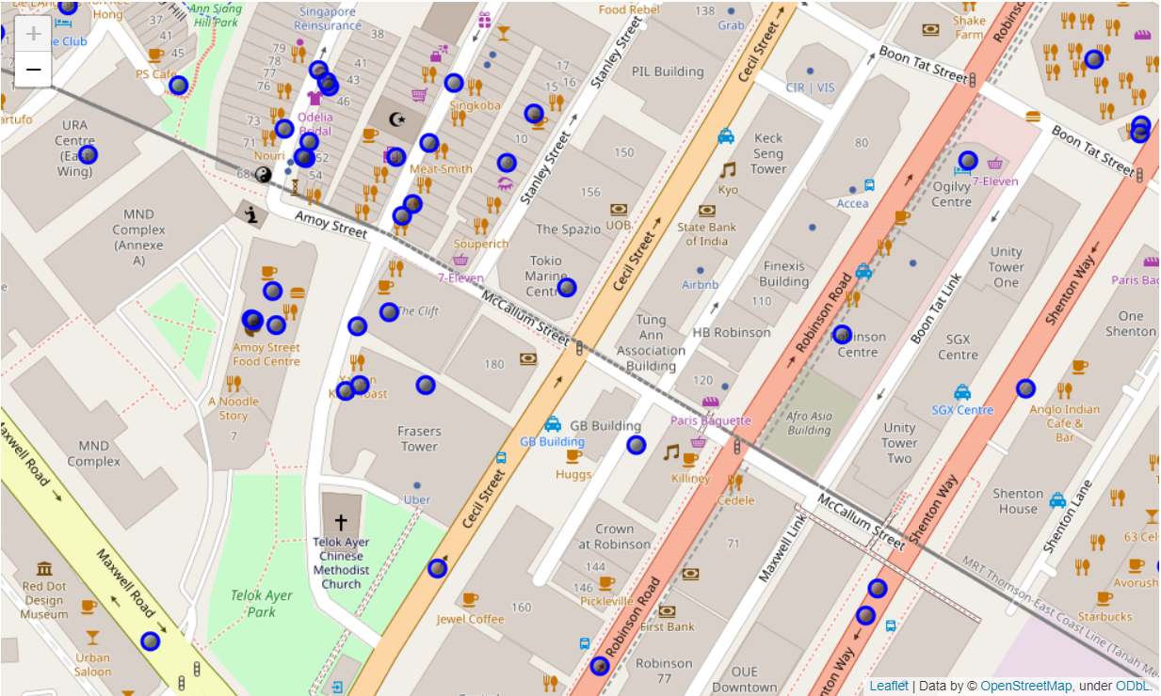
Current Neighbourhood

Slide 8
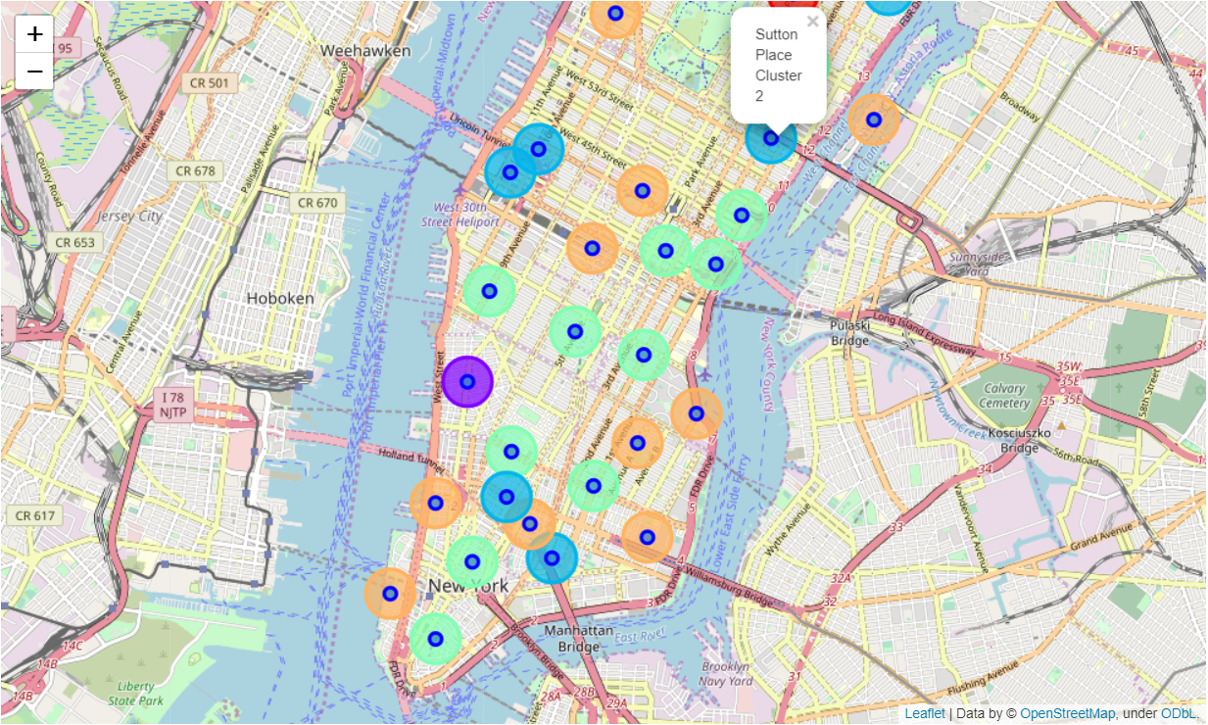
Manhattan Map Neighbourhood and Cluster of Map

Slide 9
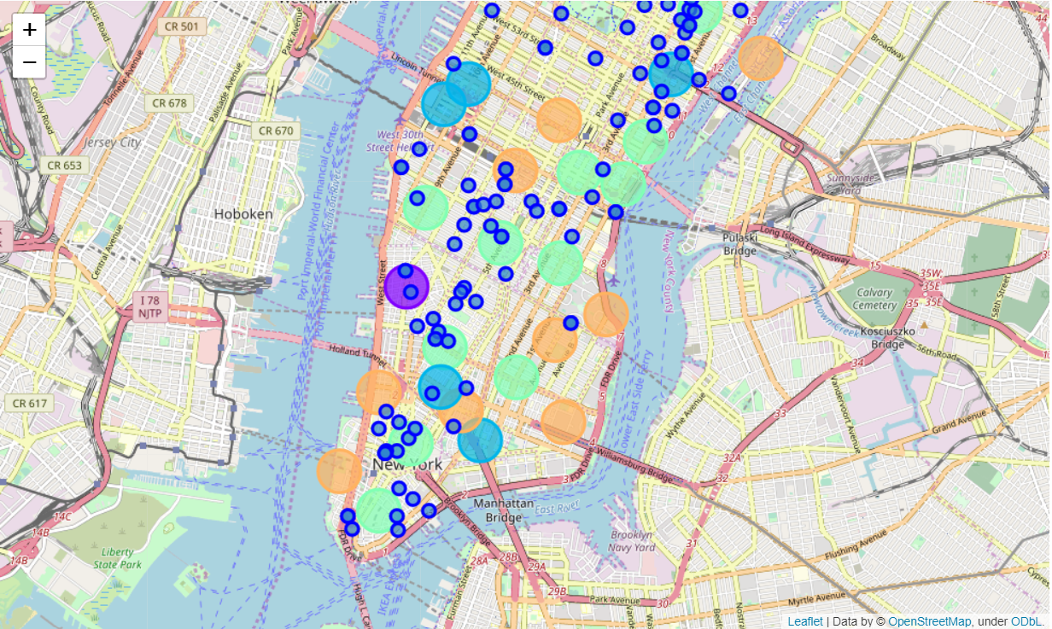
Manhattan apartments for rentswith venues cluster

Slide 10
Problem Resolution - Select the apartment for rent The above consolidate map was used to explore options. After examining, I have chosen two locations that meet the requirements which will assess to make a choice. Apartment 1: 305 East 63rd Street in the Sutton Place Neighborhood and near 'subway 59th Street' station, Cluster # 2 Monthly rent : 7500 Dollars Apartment 2: 19 Dutch Street in the Financial District Neighborhood and near 'Fulton Street Subway' station, Cluster # 3 Monthly rent : 6935 Dollars

Slide 11
THANK YOU!

